Slide 1
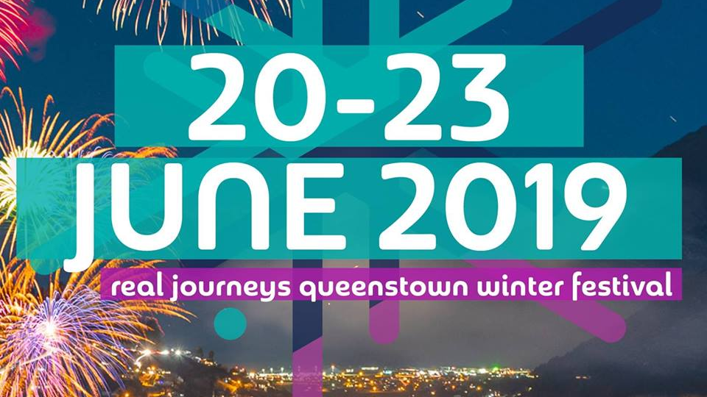
AS 91428
Contemporary Event
3 UE Reading Credits

Slide 2
QUEENSTOWN WINTER FESTIVAL
CANCELLED IN 2020
DUE TO COVID-19

Slide 3
QUEENSTOWN WINTER FESTIVAL 2021
Welcome to Winter 2021
The coolest season is almost here. While Winter Festival is on hold this year, there is still plenty to celebrate about winter!
Mark 2-4 July 2021 in your diaries and gather your mates because Queenstown will be the place to be. ‘Welcome to Winter 2021’ is going to be an action packed three days, celebrating all there is to love about the snowy season ❄️⛷️

Slide 4
QUEENSTOWN WINTER FESTIVAL 2022

Slide 5
Location of Queenstown

Slide 8
Development of Tourism in Queenstown is a Cultural Process (as it involves human activity)
External in November: One essay to write along with annotated map
Questions over the past five years are either TEMPORAL or SPATIAL or BOTH.
We will study the Queenstown Winter Festival and Queenstown Tourism Development at the same time giving you information to complete the next achievement standard on the Global Pattern of ‘International Tourism and Covid-19’. Your case study will be Queenstown.
So as we study this internal on QWF you are also learning about information for your next internal and the external on cultural processes. Does this make sense??

Slide 9
Pre-European History https://experiencequeenstown.com/news/a-short-history-of-queenstown/
Polynesians first hunted in the Queenstown area in 1200AD, but found it a bit cold for permanent settlement. Māori also travelled to Queenstown from the West Coast in search of food, stone and fibre. They used the area as a resting place and hunted the now extinct moa though they also found the region a bit too cold to live in year-round.
At the head of the lake, near modern day Glenorchy, Māori travellers found pounamu (greenstone). The highly prized pounamu was used to create tools and beautiful ornaments. Carved pounamu pendants are still popular today and are often presented as a special gift, or as a symbolic keepsake for a traveller.
The Māori name for Queenstown is Tāhuna, meaning shallow bay.

Slide 10
Pastoral History
Scotsman Nathanael Chalmers was the first European to see Lake Wakatipu, in September 1856; he was led there by Reko, a Māori chief.
In 1860, William Gilbert Rees and Nicholas Paul Baltasar von Tunzlemann took the Crown Range route between Wanaka and Queenstown. Rising to 1,121 metres it’s now the highest main road in New Zealand and an easy route between the two towns in the summer months (note: it can be a difficult drive during winter!) But in Tunzlemann and Rees’ day, it was a difficult and dangerous route year-round.
The pair were the first to settle permanently in the area. Rees established his homestead in the heart of what’s now Queenstown’s CBD and Tunzlemann ran sheep and worked the land at the other side of the lake.

Slide 11
Gold
Jack Tewa, a Māori shepherd who was working for Rees, discovered alluvial gold in the Arrow River in 1862. It wasn’t long until his fellow workers, William Fox and John O’Callaghan found significant deposits and the gold rush began.
Miners flooded in from the Australian and Californian goldfields and a canvas shanty town sprung up on Rees’ farm. Rees was paid 10,000 pounds (the commonly used currency at that time) to give up his land and he turned his wood shed into a hotel called the Queen’s Arms. This later became Eichardt’s Hotel.
Tunzlemann was not so lucky. Many of his sheep died and eventually, he was forced to leave his land.
The Shotover River became the second richest gold bearing river in the world, but the rush didn’t last long. Within two years the gold began to run out and in 1864, miners followed the rush to West Coast where more gold had been found.
Income tax on the gold had been a big source of income for region, so the government invited Chinese miners to work on the Otago goldfields. More than 5,000 Chinese were living and working in the area by the 1870s. They worked hard to find gold left behind after the initial rush, but few made enough money to return home. They set up market gardens and worked as builders to supplement their meagre income and lifestyle.

Slide 12
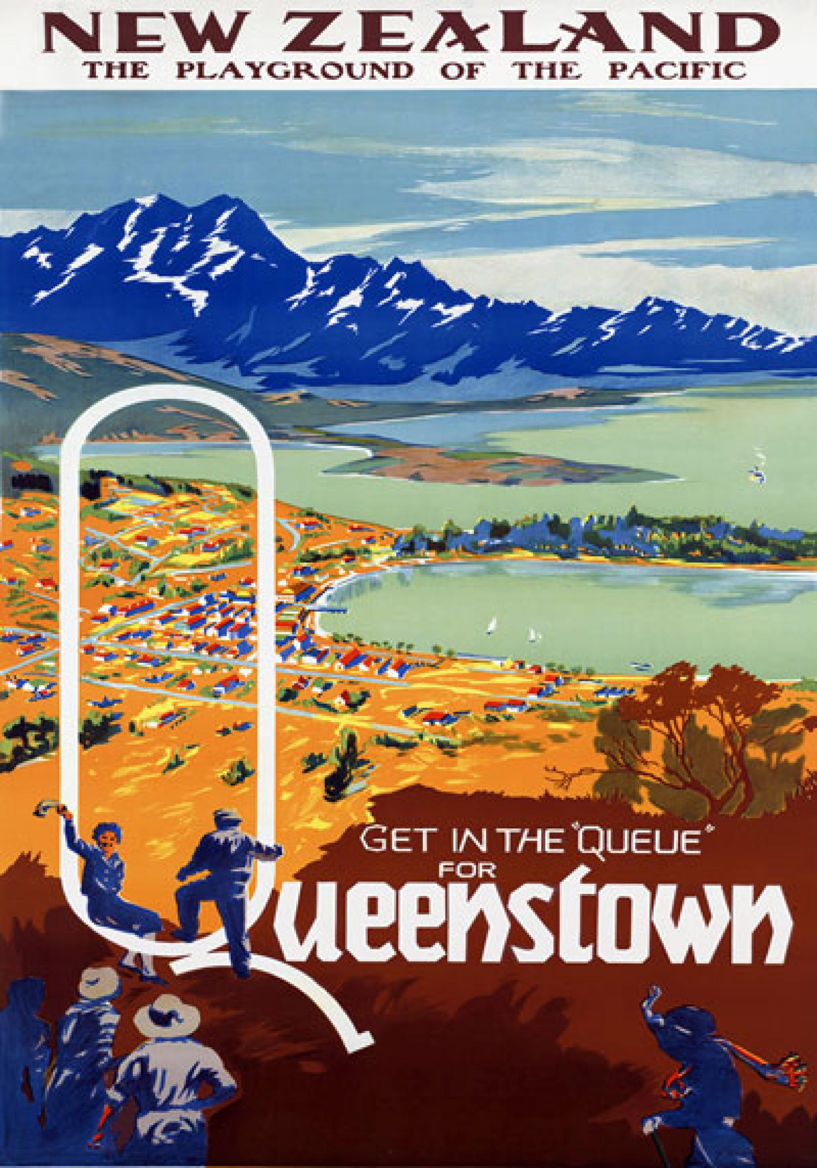

Slide 13
Tourism
Infrastructure was put in place during the gold rush made it easier for tourists to get to Queenstown. Hotels were built at Kinloch and Glenorchy in the mid-1870s and the Dunedin to Kingston railway was established shortly afterward.
At first, tourists flocked to Queenstown in Summer for hiking and walking
1947, the Mt Cook Company hired a ski instructor and put in a tow rope on Coronet Peak
1960 saw the first commercial jet boat rides
1965 Shotover Jet commenced in Kawarau Gorge
1988, the world’s first commercial bungee jumping began thanks to entrepreneurs AJ Hackett and Henry Van Asch.
Growth has skyrocketed since the 1950s, and now Queenstown offers a whole range of activities and experiences.

Slide 14
Ngai Tahu Tourism https://www.ngaitahutourism.co.nz/
Ngai Tahu Tourism purchased a stake in Shotover Jet in 1999 and two years later bought out previous owner Jim Boult (the current Mayor of Queenstown Lakes District) and others to acquire 88% of the company. They purchased the company outright in 2004.
The Shotover Jet operation has thrilled more than 3 million people since 1965.

Slide 15
1975 – The first Queenstown Winter Festival https://www.rnz.co.nz/news/national/247703/queenstown-winter-festival-turns-40
1975 - The first Queenstown Winter Festival.
Queenstown musician Peter Doyle and local pub manager Laurie Wilde pulled together a team of keen residents and tourism operators for a party. Their premise was to have some fun and hopefully generate some publicity about the upcoming winter season.
In 1975, Queenstown had one ski field and snow making machines were not invented yet. Ski season did not start until late July
Clive Geddes was on that first committee and fondly recalls the first mad-cap event. "There was cow-pat throwing and waiters' races, with all the hospitality workers running through the streets balancing trays of champagne," Mr Geddes said.
Jenny McLeod was a budding local journalist in 1975. She was dispatched to report on the cow-pat throwing competition and was quickly roped in as a contestant. "Bill Tapley owned the CattleDrome. He spent the whole year freezing cow-pats and when I turned up, I was told to line-up and have a go. The rest is history. I threw mine and I won."

Slide 16
1975 – The first Queenstown Winter Festival https://www.rnz.co.nz/news/national/247703/queenstown-winter-festival-turns-40
1975 - The first Queenstown Winter Festival. (continued)
Queenstown musician Peter Doyle and local pub manager Laurie Wilde pulled together a team of keen residents and tourism operators for a party. Mrs McLeod said another memory from that year was the wheelbarrow race. She was pushed along by Alan Bradey, who, years later, would pioneer Central Otago's wine industry. "He was on roller skates and you can imagine the carnage at the end of the race as these wheelbarrows and guys on roller skates hit the finish line."
The success of that first year spurred the organising committee on and by the late 1970's the Queenstown Winter Festival was a firm fixture on the calendar.
Stuart McLean was one of the early volunteers who helped run the event. He said by the mid-1980's Queenstown was really booming as a ski destination, but the festival held true to its roots. "There were no OSH regulations in those days. We used to send people careering down Man Street on homemade trolleys. How someone didn't die I'll never know," Mr McLean said.

Slide 17
1990s – Queenstown Winter Festival
As the 1990's dawned it was clear the event could no longer be run by volunteers and one of the first paid festival directors was David Kennedy. He said he had no idea how to run an event and asked what could be done to secure a stage.
"The reply was simple, you ring Northern Southland Transport and give them a slab of beer and they'll bring around a truck," Mr Kennedy said.
Road closures weren't a problem then either. There was none of the red tape and bureaucracy which surrounds a major event of today.
"I just wrote a one page letter to the council telling them I wanted to close half the roads in the town for ten days and they wrote back saying - no problem," Mr Kennedy said.

Slide 18
Queenstown Winter Festival (article written 20 June 2014 - https://www.rnz.co.nz/news/national/247703/queenstown-winter-festival-turns-40)
Radio New Zealand presenter Wayne Mowat said he loved covering the festival.
"I recall the New Zealand Symphony Orchestra on a barge in the middle of the lake. Then just at the right moment Sir Tim Wallace swooped down out of the snowy clouds and dive bombed the lake in his Spitfire. I thought I had died and gone to heaven it was so magic," Mr Mowat said.
In 1999 the festival almost went bust. David Kennedy who was by that time the chief executive of Destination Queenstown said the event had been contracted out to private enterprise and it didn't go according to plan. The festival director Lindsay Singleton left town the night the festival opened and while the event went ahead he left a trail of debt and misery in his wake.
"I think that it survived that episode shows how important the festival is to Queenstown because ultimately at its heart is the local community. It really is their event," Mr Kennedy said.

Slide 19
Queenstown Winter Festival (continued) (article written 20 June 2014 - https://www.rnz.co.nz/news/national/247703/queenstown-winter-festival-turns-40)
Radio New Zealand presenter Wayne Mowat said he loved covering the festival.
Phillip Chandler, local Mountain Scene journalist, said sponsorship has enabled the festival to offer as many as 70 different events, most of them free.
"There is no way you could do that without the family of sponsors the organisers who have pulled together over the years."
Today, the Queenstown Winter Festival is a slick machine welcoming over 45,000 visitors to the town. It generates $57 million for thelocal economy.
Festival director Lisa Buckingham said the event is in good heart and while some tweaking may be needed to keep it relevant in future years there's no reason why it won't keep going to see another 40 years.

Slide 20
QUEENSTOWN WINTER FESTIVAL 2019 PROGRAMME https://www.winterfestival.co.nz/programme

Slide 22
AS 91428 - 3 UE reading credits
Task A – outline the nature of the QWF
Task B – Explain and evaluate the planning and decision making of the QWF
Task C – what are the social, economic and environment impacts (both positive and negative)

Slide 23
MARKING SCHEDULE A= 3A or 2A, 1M M=1A. 2M or 1A, 1M, 1E E= 1A, 2E NA= any 2 at A, M, E
Evidence for Achievement | Evidence for Achievement with Merit | Evidence for Achievement with Excellence
The student analyses a significant contemporary event from a geographic perspective. This means that the student: | The student analyses, in depth, a significant contemporary event from a geographic perspective. This means that the student: | The student analyses comprehensively a significant contemporary event from a geographic perspective. This means that the student:
TASK 1 Outlines the nature of the event from a geographic perspective, such as the spatial nature of the event, interaction between people and the environment, and characteristics of the natural and/or cultural features that make up the event. | Task 1 – marked as achieved only | Task 1 – marked as achieved only
TASK 2 Explains the planning and decision-making process | TASK 2 explains in detail the planning and decision-making involved in the event | TASK 2 explains in detail and evaluates the planning and decision making involved in the event. The evaluation must indicate the effectiveness of the components of the planning and decision-making. This may, for example, include how people’s values, perceptions, and perspectives influenced decision-making processes

Slide 24
MARKING SCHEDULE (CONTINUED) A= 3A or 2A, 1M M=1A. 2M or 1A, 1M, 1E E= 1A, 2E NA= any 2 at A, M, E
TASK 3 Identifies and explains the social, economic and/or environmental impacts of this event AND uses geographic terminology and concepts AND supports their analysis with relevant evidence. This may include visual material such as diagrams, graphs, tables, and other appropriate visual media. | TASK 3 Explains in detail the social, economic and/or environmental impacts of the event. These could include both positive and negative impacts AND uses appropriate geographic terminology and concepts AND supports their in-depth analysis with relevant detailed evidence that may include visual material such as diagrams, graphs, tables, and other appropriate visual media. | TASK 3 Explains in detail and evaluates the social, economic, and/or environmental impacts of the event. This could include a discussion of both positive and/or negative impacts. The evaluation should include a judgement as to the significance of the impact, or comparison of the level of impact the event has on the different aspects AND consistently uses appropriate geographic terminology and concepts throughout their analysis AND supports their analysis and evaluation with a range of relevant detailed evidence that may include diagrams, graphs, tables, and other appropriate visual media. Their significance is explained and shows insight Concepts may include how people’s values, perceptions, and perspectives influence decision-making processes. The student shows an understanding of the concept that there is an interaction of all anticipated impacts of the event and that this is a fundamental part of planning and decision-making.

