Slide 1
So what type of clouds are these?

Slide 3
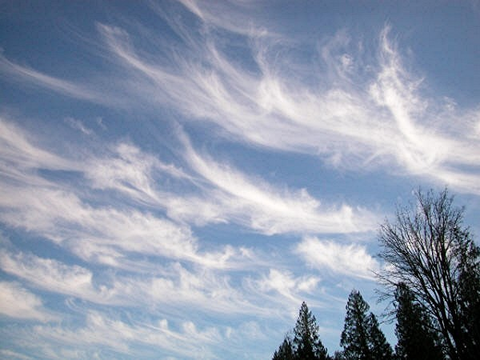

Slide 4
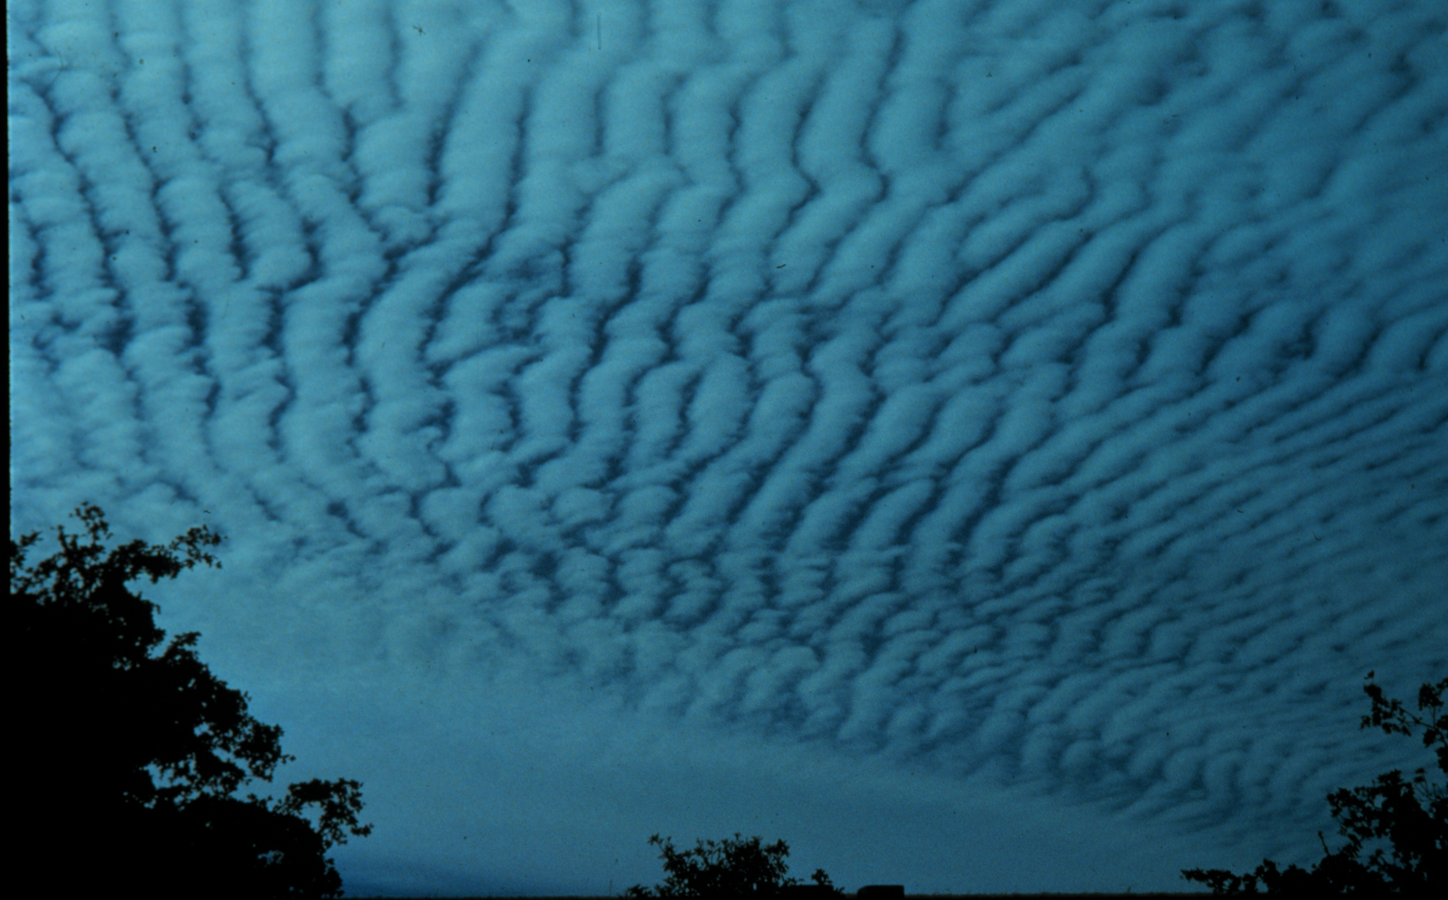

Slide 7
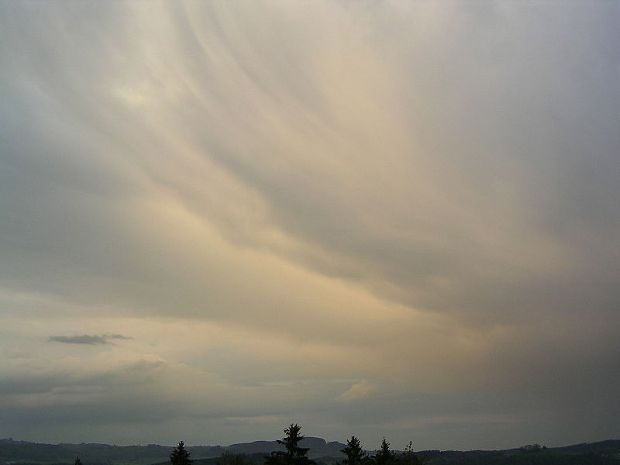

Slide 8
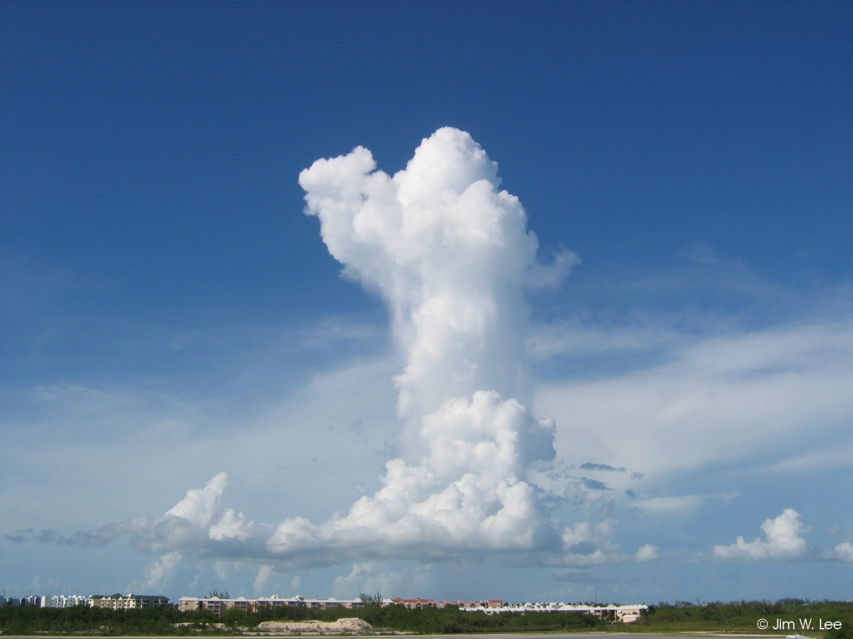

Slide 10
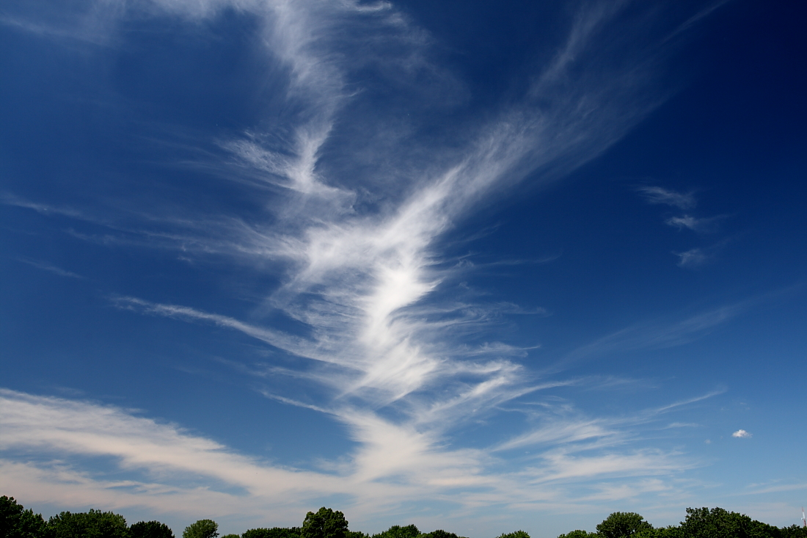

Slide 11
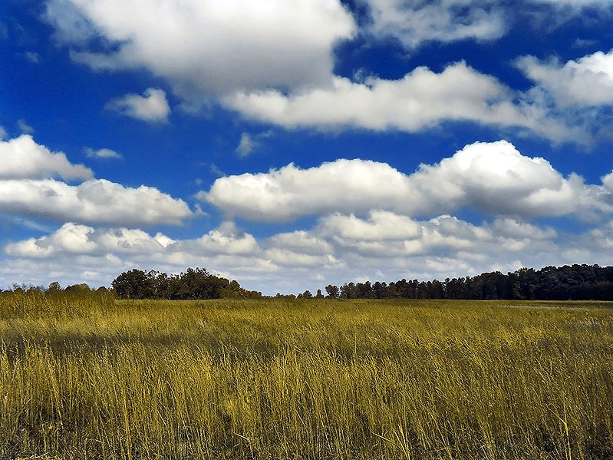

Slide 12
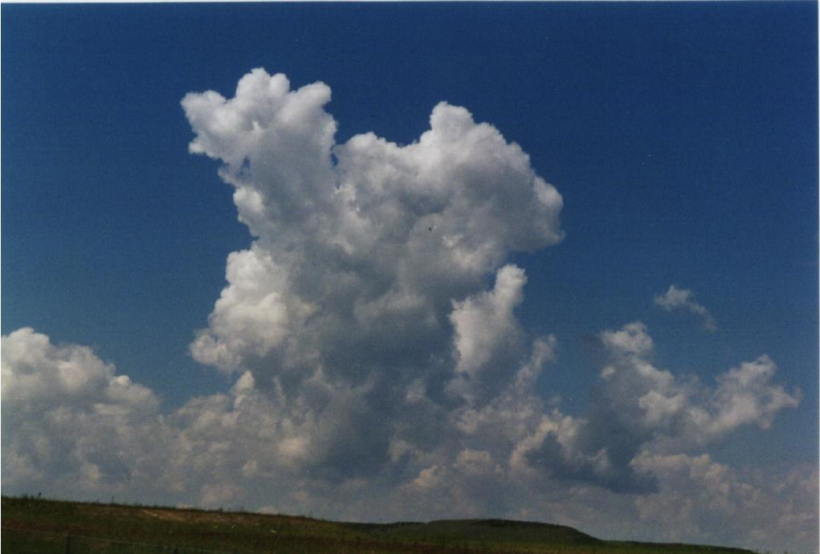

Slide 13
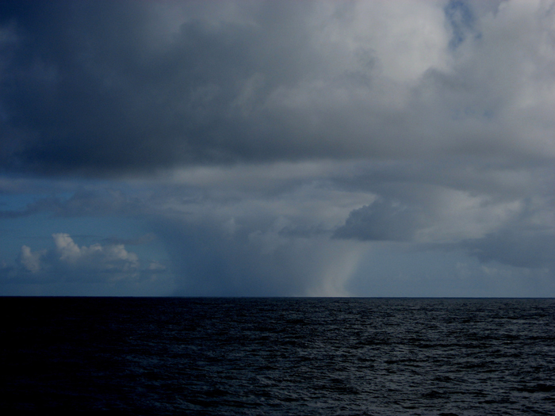

Slide 14
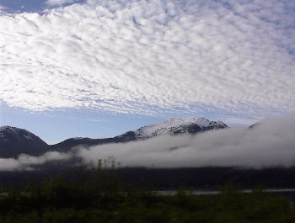

Slide 15
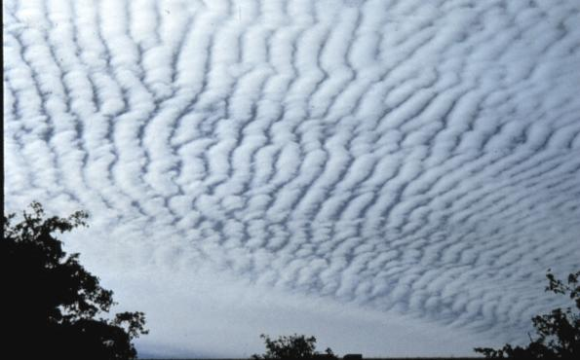

Slide 18
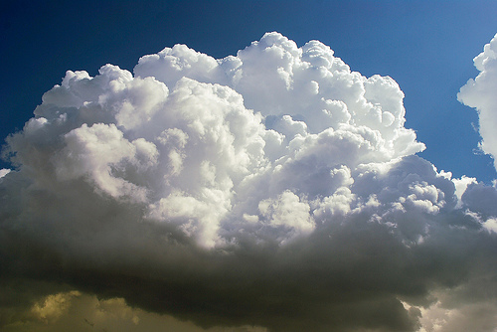

Slide 21
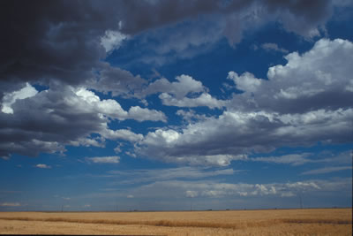

Slide 22
Introduction slide
Cumulus
Cirrus
Altocumulus
Cumulus
Altocumulus and cirrus
Cirrus
Cumulonimbus
Cirrus
Altostratus
Cumulus
Altocumulus
Cumulonimbus
Stratus
Stratus
Altostratus
Stratocumulus
Cumulonimbus
Cirrocumulus
Altostratus and cumulonimbus
Cumulus

