Slide 1
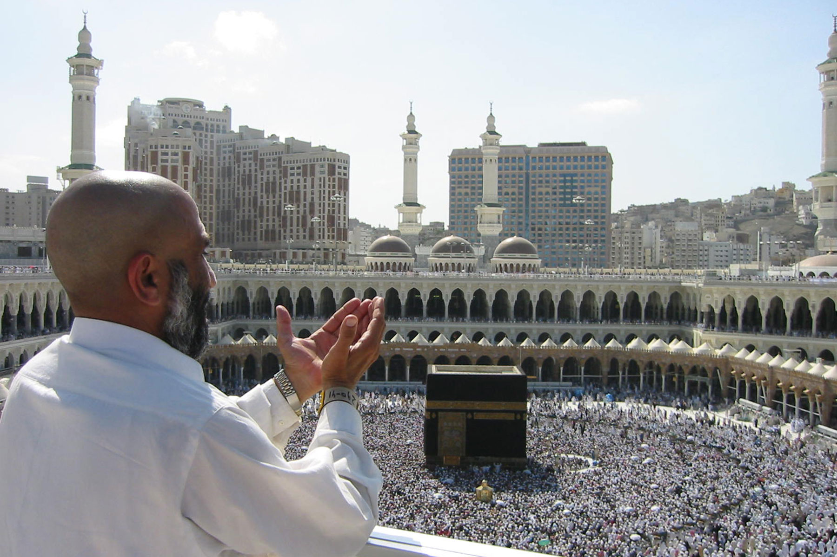
The Hajj: The annual migration of pilgrims to Mecca, Saudi Arabia

Slide 2
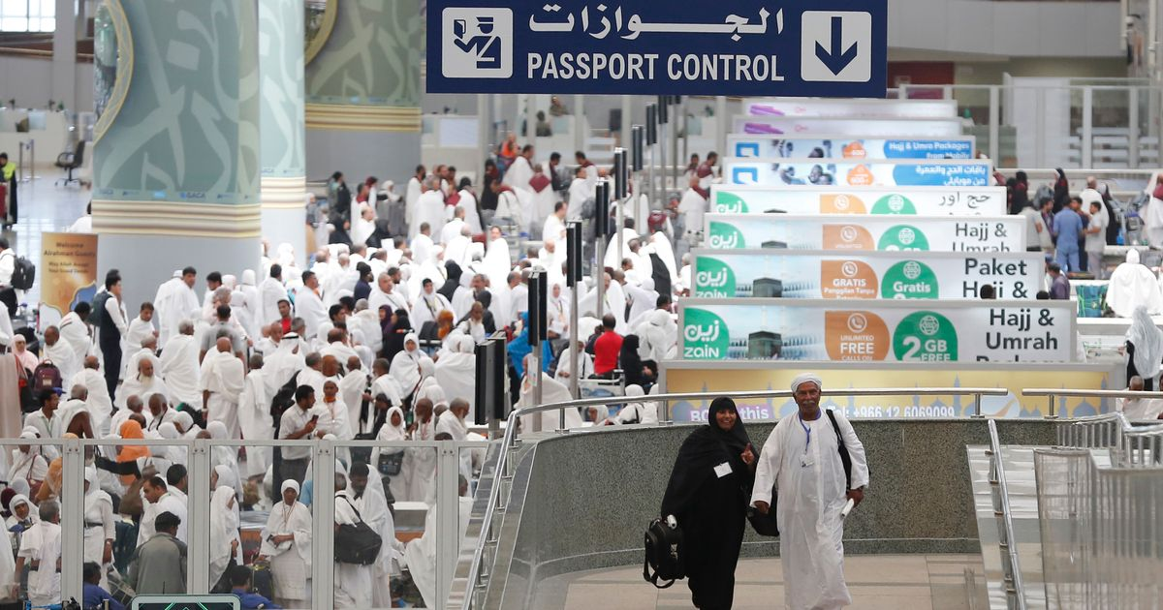
Background: What is the Hajj?
The Hajj, sometimes spelt Haj, is the annual pilgrimage to Mecca that Muslims are expected to make at least once in their lifetime. The word Hajj is an Arabic word, meaning ‘to intend a journey’. In 2020, the Hajj will take place between 28 July and 2 August. This migration attracts over 2 million pilgrims a year.
Pilgrims at Jeddah Airport, Saudi Arabia

Slide 3
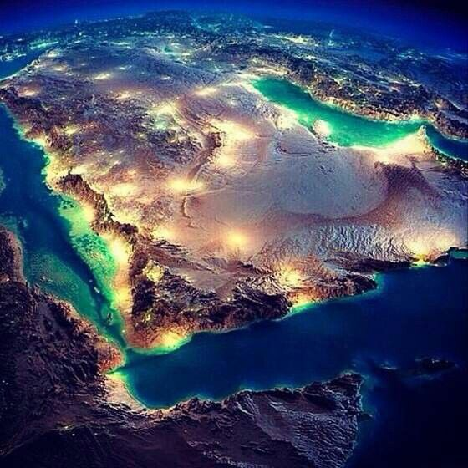
Arabian Peninsula at night

Slide 4
Relevant Geographic Concepts
Interaction
Involves elements of an environment affecting each other and being linked together. Interaction incorporates movement, flows, connections, links and interrelationships which work together and may be one or two way interactions. Landscapes are the visible outcome of interactions. Interaction can bring about environmental change.
Environments
May be natural and/or cultural. They have particular characteristics and features which can be the result of natural and / or cultural processes. The particular characteristics of an environment may be similar to and/or different from another. A cultural environment includes people and/or the built environment.

Slide 5
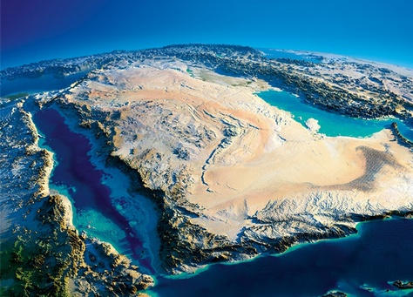
Photo Interpretation
Use the snipping tool to take a capture of this photo.
Use your device and websites to locate on your image the following features:
Saudi Arabia Border
Mecca
Jeddah
The deep water in the Red Sea
Strait of Hormuz
Qatar

Slide 6
Hajj: A religious pilgrimage
https://www.youtube.com/watch?reload=9&v=VMWgeSuHKhs
Watch this clip and answer these questions:
1. How many times and what direction do Hajj pilgrims move around the kabaa?
2. What are women not permitted to wear at the Hajj?
3. How much is the Hajj worth to tourism in Saudi Arabia?

Slide 7
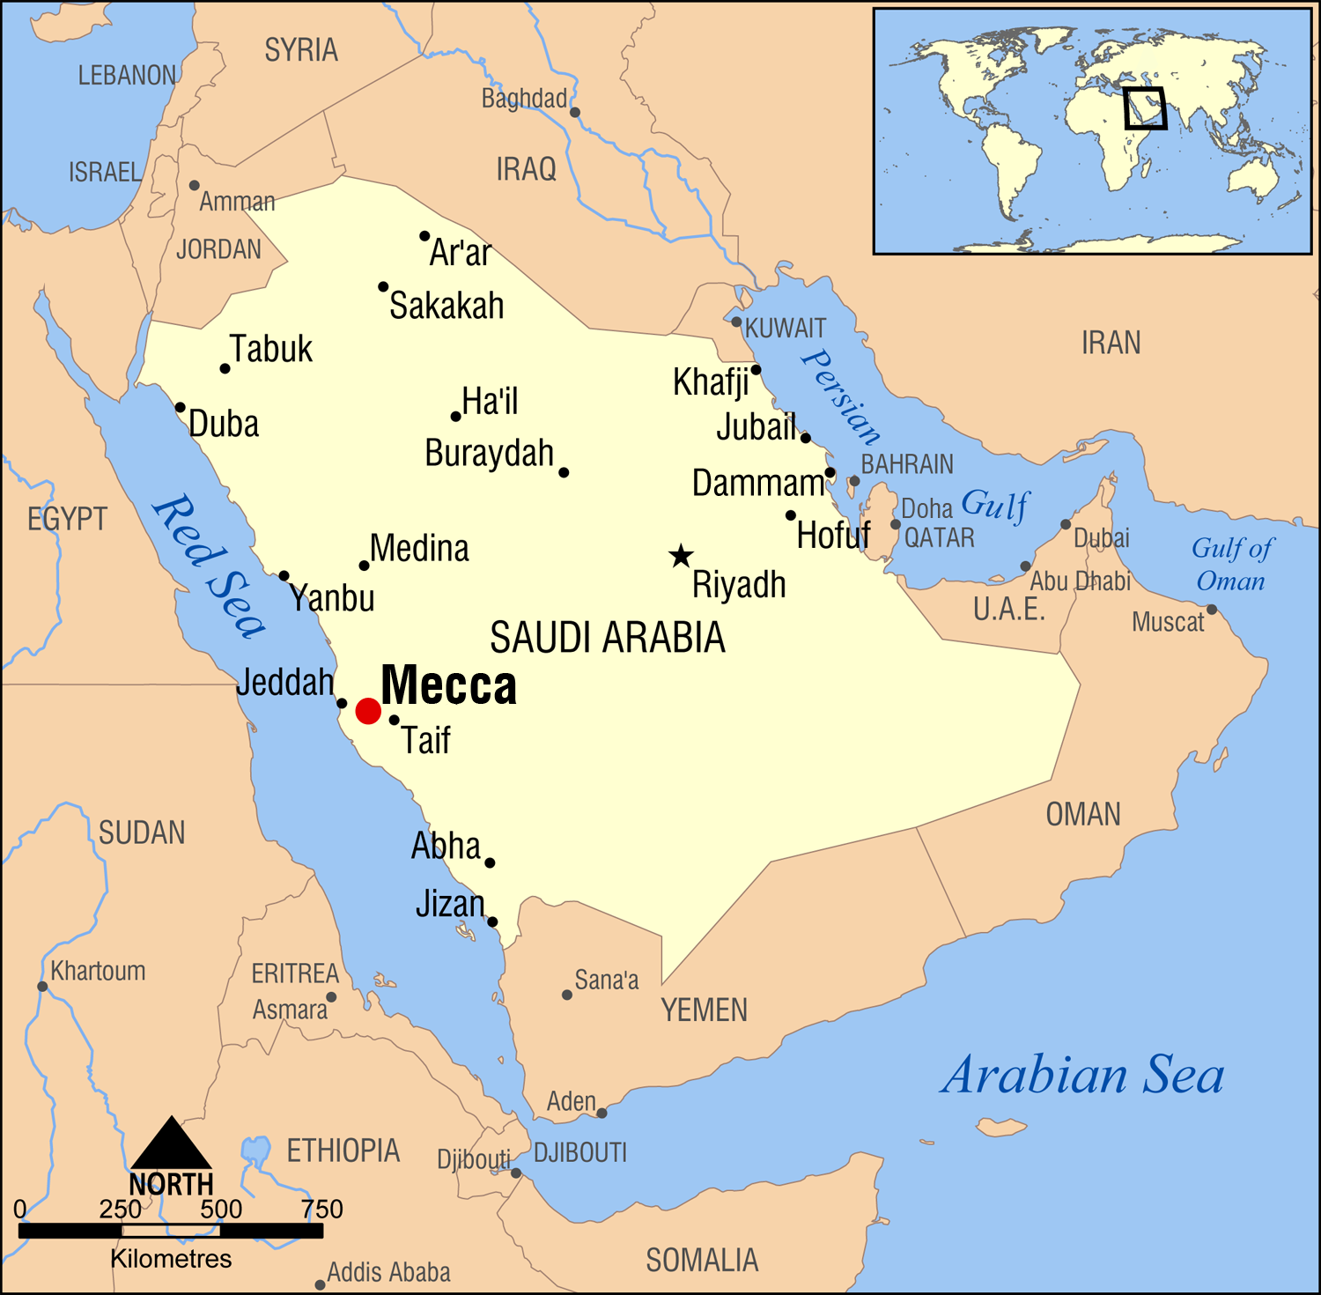
Location of Mecca
Describe the location of Mecca in Saudi Arabia.
Remember to use specific geographic terminology in your answer. For example:
Is it close to certain cities? Which ones?
Is it near a coastline?
How far away and what direction is it from the capital Riyadh?

Slide 8
COVID-19 and the 2020 Hajj
https://www.aljazeera.com/news/2020/04/praying-time-covid-19-world-largest-mosques-adapted-200406112601868.html
Read through the article and answer the following questions:
Which date were prayers suspended in Mecca's Grand Mosque?
What has the current call to pray had added to it at the end?
How many COVID-19 cases and deaths has Saudi Arabia had at the time this article was written?
How many cases of COVID-19 does Saudi Arabia have now?

Slide 9
Domestic and Foreign Pilgrims to Mecca 2008 -2019
YEAR | DOMESTIC | FOREIGN | TOTAL
2008 | 699,313 | 1,613,965 | 2,313,278
2011 | 1,408,641 | 1,752,932 | 3,161,573
2013 | 696,185 | 1,389,053 | ?
2015 | 537,537 | 1,325,372 | 1,862,909
2017 | 612,953 | 1,758,722 | 2,371,675
2019 | 634,379 | 1,855,027 | ?
Source: stats.gov.sa
Draw a multi-line graph of the DOMESTIC, FOREIGN and TOTAL numbers of pilgrims to Mecca between 2008 and 2019.
Describe the temporal pattern of the TOTAL number of pilgrims to Mecca between 2008 and 2019.

Slide 10
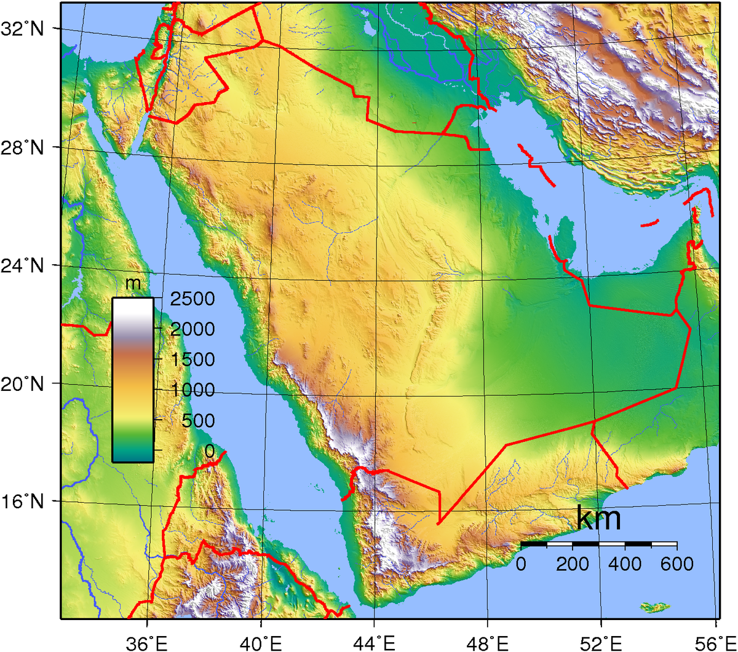
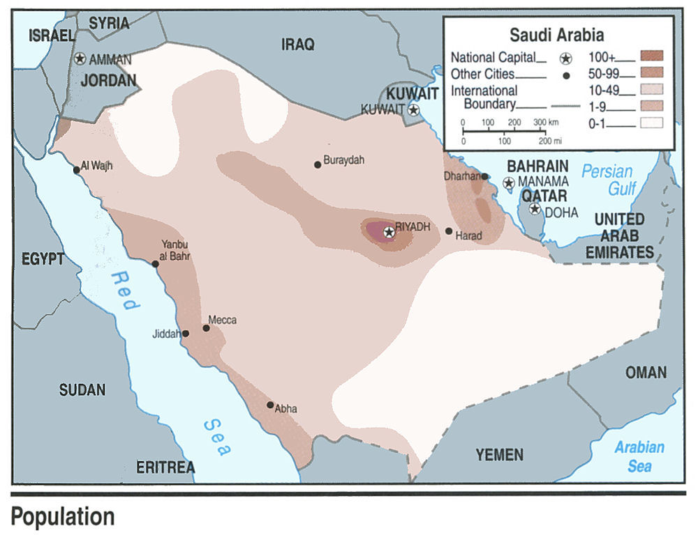
Describe the relationship between relief and population density in Saudi Arabia.

Slide 11
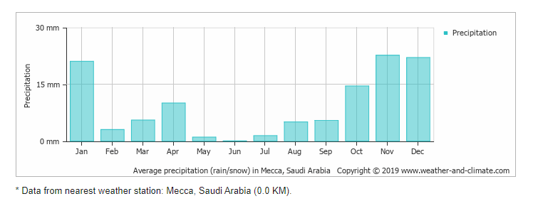
Climate graph - Mecca
Which month receives the lowest precipitation in Mecca?
In what season does Mecca receive the most precipitation
What is the average annual rainfall in Mecca?
Why might the lack of rainfall in Mecca be an issue for the city annually hosting two million pilgrims to Hajj?

Slide 12
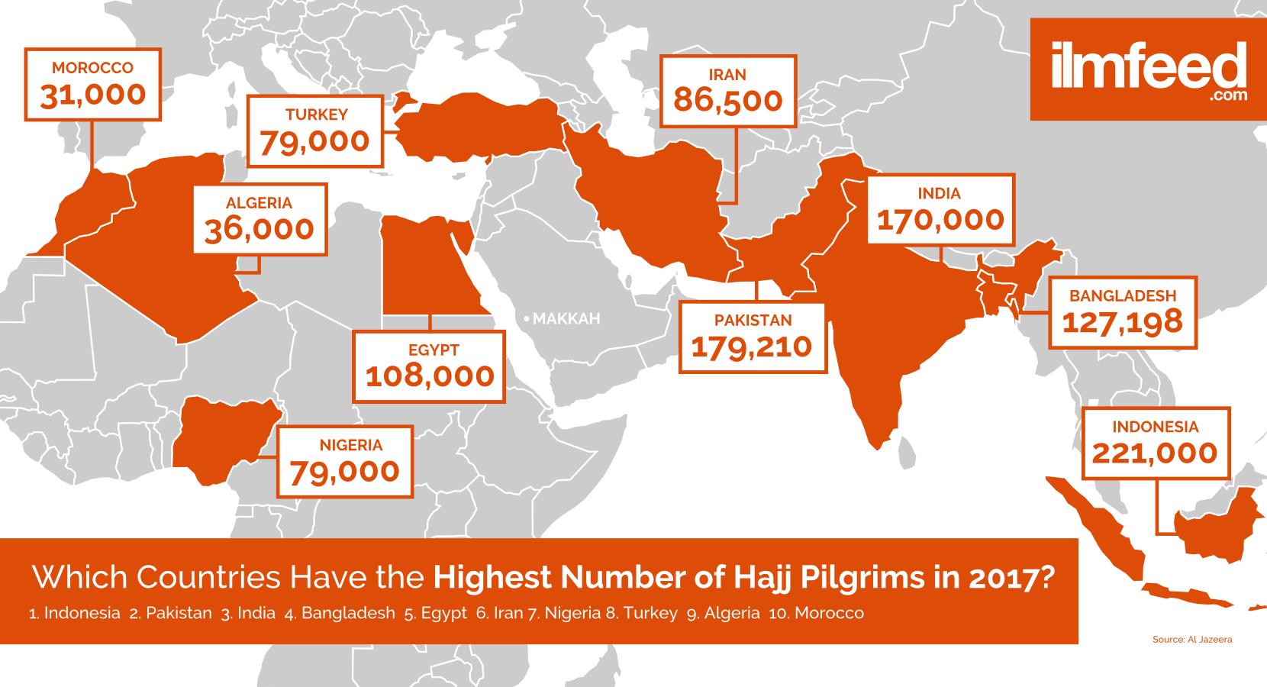
Which region of the world provided the top 4 countries for the number of foreign pilgrims to Hajj in 2017?

Slide 13
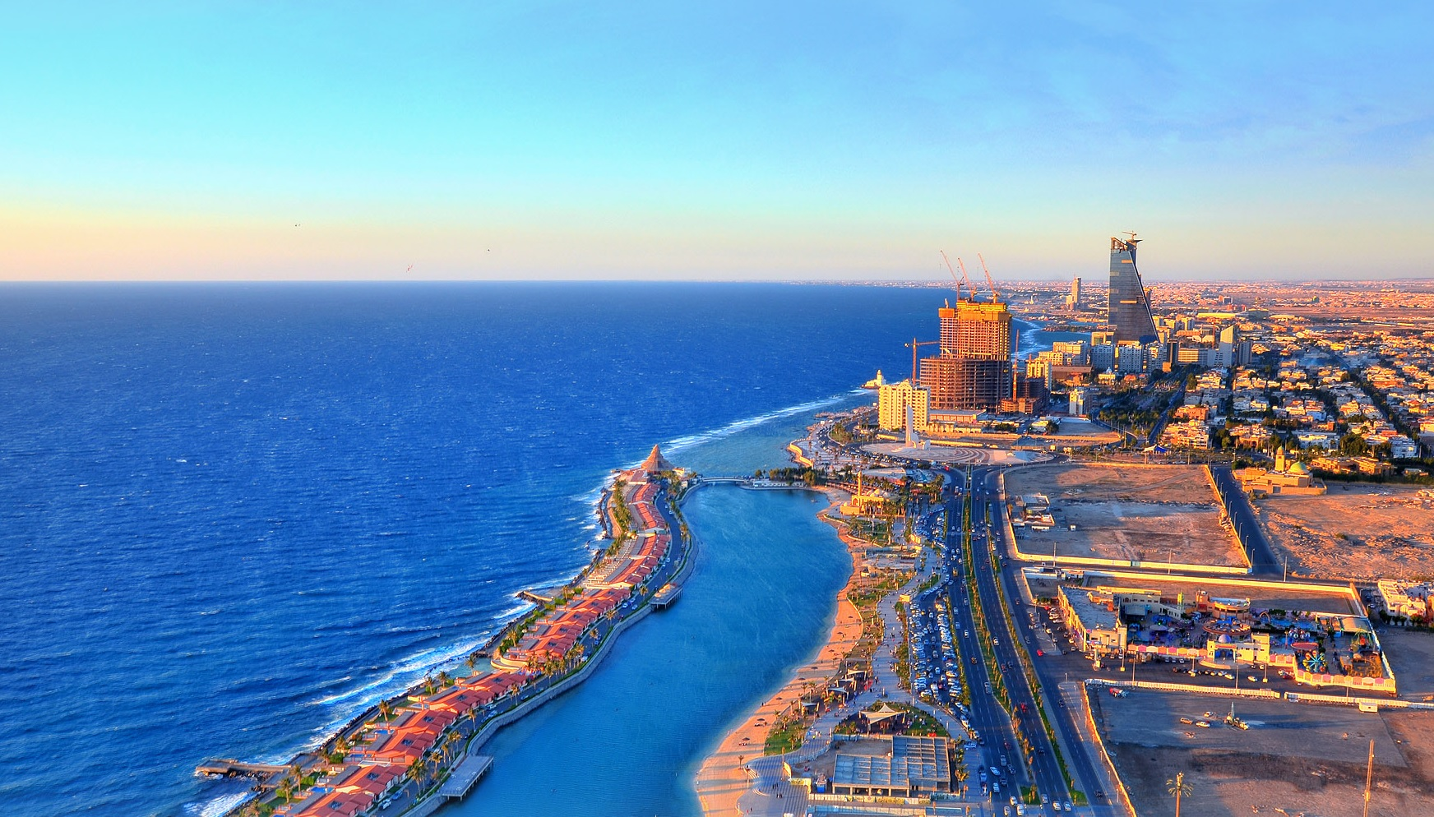
Use the frame in the next slide to draw precis sketch of this scene. Include the man-made island, tall buildings, main road, beach and low-rise buildings east of the tall buildings in your sketch.

Slide 14
Precis Sketch of Jeddah

Slide 15
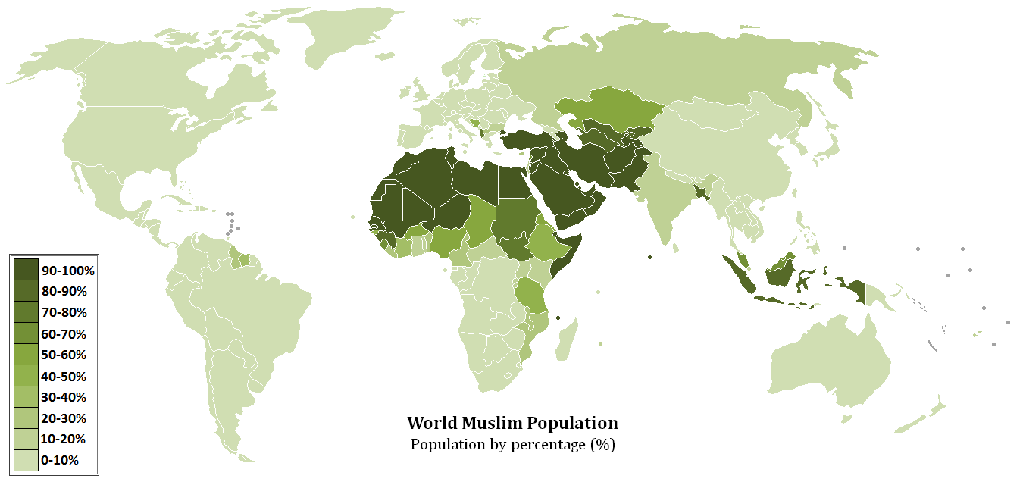
Describe the global pattern of the World Muslim Population
In your answer you need to refer to specific locations (continents, tropics, equator), use geographic spatial pattern terminology (scattered, radial, linear etc) and state where the pattern is not apparent.

Slide 16
How many Muslims are there in NZ?
YEAR | NUMBER
1986 | 4,000
1996 | 13,545
2001 | 23,631
2006 | 36,072
2013 | 46,149
2018 | 57,276
Choose an appropriate graphing technique to represent this data.
When was the largest increase in the Muslim population in NZ?
Source: StatsNZ

Slide 17
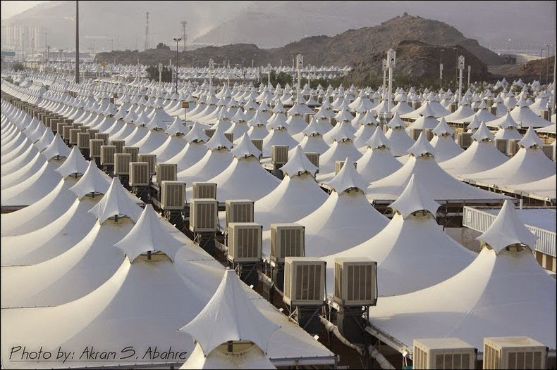
Some of the 100,000 air conditioned tents for Hajj pilgrims at Mina near Mecca

Slide 18
Changes to Mecca over time
https://www.theatlantic.com/photo/2015/09/mecca-then-and-now-128-years-of-growth/408013/
https://www.theguardian.com/cities/2016/sep/14/mecca-hajj-pilgrims-tourism
https://www.theguardian.com/world/2015/sep/24/timeline-of-tragedies-in-mecca-during-hajj
Read through all THREE of these articles and note down changes to the cultural and physical environment of Mecca over time.

Slide 19
Flow Diagram: Hajj and change in the number of pilgrims and environment of Mecca
Use the diagram on the next slide to explain how an increase in the number of pilgrims has brought about changes for the environment of Mecca. Clearly identify on your diagram, TWO changes that can be perceived as positive, and TWO changes that can be perceived as negative. Use specific information from The Guardian and Atlantic articles in your answer.

Slide 20
Increase in pilgrims to Mecca from 200,000 in 1960s to over 2 million in 2019
Increase in demand for food, accommodation and transport

Slide 21
Accessibility to Mecca for Qatari Muslims
In July 2017, Saudi Arabia, the UAE, Bahrain and Egypt closed their airspace to Qatar Airways and Qatari-owned airlines. Qatar was accused of supporting “terrorist” groups in the region, so Qatari-operated flights from Doha to these countries were banned. Other airlines, though, can fly over the blockading states on condition that permission is sought 24 hours beforehand, and the details of the crew and passengers are passed to their relevant authorities.

Slide 22
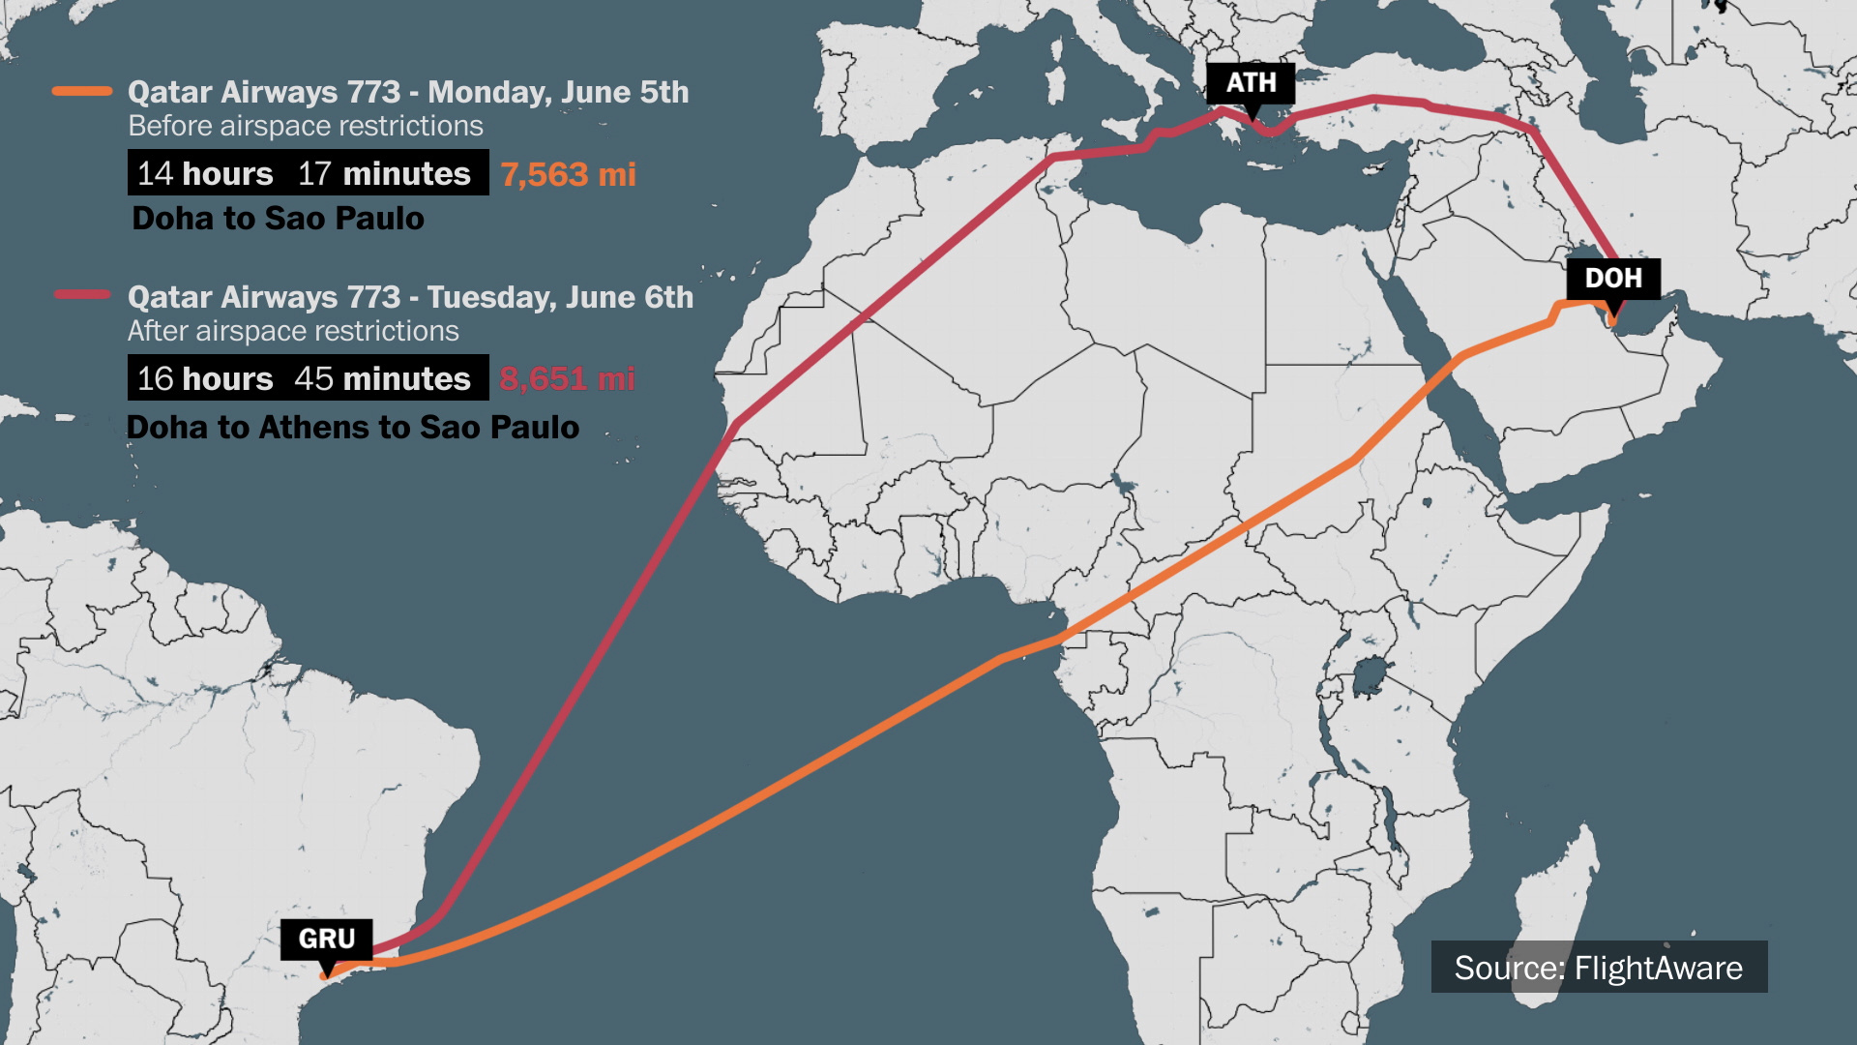
How much longer (flight time AND distance) does it take a flight from Doha to Sao Paulo on Qatar Airways if its planes cannot fly over Saudi Arabia airspace?

Slide 23
Apply a Geographic Concept
Explain how the geographic concept of interaction applies to the Hajj at Mecca in Saudi Arabia.
In your answer you should specifically refer to the concept AND include specific information from the different resources.
Sentence Starter:
The Hajj at Mecca in Saudi Arabia attracts over two million pilgrims a year. Many of these pilgrims come from foreign countries. These pilgrims interact……..

